Slide 1



Progressing Alzheimer’s Diagnosis with Ensemble CNN Model
VIVEK YADAV
CSE Department KIET Group of Institutions, Delhi-NCR Ghaziabad, India
Paper ID: 1042
Vivek yadav , Vaibhav , Rohit , Sushil Kumar , Umang Rastogi
3rd International Conference on Disruptive Technologies (ICDT-2025) Technically Co-Sponsored by IEEE UP Section (INDIA)

Slide 2
Introduction
Alzheimer’s disease (AD) is a chronic, irreversible neurodegenerative disorder affecting memory, reasoning, and judgment.
It progresses silently for decades, making early detection crucial for better disease management.
Traditional diagnosis methods rely on expert evaluation, which is time-consuming and inconsistent.
Convolutional Neural Networks (CNNs) help automate feature extraction from MRI images, improving accuracy.
The model uses AMD Radeon Vega 8 Graphics for faster processing and reduced training time.
Adaptive Synthetic Oversampling addresses dataset imbalance for better CNN performance.
The proposed method achieves 97% accuracy, making it a cost-effective and efficient tool for early AD diagnosis.
ICDT - 2025
3rd International Conference on Disruptive Technologies (ICDT-2025) Technically Co-Sponsored by IEEE UP Section (INDIA)

Slide 3
Background of the Paper
Alzheimer’s disease (AD) is a neurodegenerative disorder that affects memory and cognitive functions, with increasing global prevalence.
Early diagnosis is crucial but challenging due to the disease's gradual onset and reliance on expert evaluation.
Deep learning, especially Convolutional Neural Networks (CNNs), has improved medical imaging by automating feature extraction.
Computational challenges exist in processing large MRI datasets, often requiring high-end GPUs for efficiency.
This study utilizes AMD Radeon Vega 8 Graphics to enhance processing speed and reduce hardware costs.
Deep Learning & Neural Networks – Application of CNNs, transfer learning, and ensemble models in medical imaging.
Medical Image Analysis – MRI classification techniques and handling of imbalanced datasets for better diagnosis.
High-Performance Computing & GPUs – Role of GPUs in accelerating deep learning models for real-time clinical applications.
ICDT - 2025
3rd International Conference on Disruptive Technologies (ICDT-2025) Technically Co-Sponsored by IEEE UP Section (INDIA)

Slide 4
Related works
1. Early Machine Learning Approaches
Support Vector Machines (SVMs) & Random Forest (RF) were used for AD classification based on MRI scans and cognitive tests.
Decision Trees & K-Nearest Neighbors (KNN) were explored for distinguishing AD from Mild Cognitive Impairment (MCI).
2. Deep Learning-Based AD Diagnosis
LeNet5 & GoogleNet were applied to AD MRI datasets, achieving 94.79% and 96.84% accuracy, respectively.
ResNet50 Hybrid Model outperformed traditional CNNs with 90% accuracy.
VGG16-Based CNN reached 95.7% accuracy in AD detection using MRI images.
ICDT - 2025
3rd International Conference on Disruptive Technologies (ICDT-2025) Technically Co-Sponsored by IEEE UP Section (INDIA)

Slide 5
Problem Formulation
Imbalanced datasets make Alzheimer’s diagnosis less accurate.
High computational costs limit accessibility and scalability.
Poor early-stage detection reduces treatment effectiveness.
Existing CNN models struggle with generalization and require expensive hardware.
Proposed Solution: An Ensemble CNN model optimized for AMD Radeon Vega 8 GPU, using adaptive oversampling for balance and Grad-CAM for explainability.
ICDT - 2025
3rd International Conference on Disruptive Technologies (ICDT-2025) Technically Co-Sponsored by IEEE UP Section (INDIA)

Slide 6
Proposed Methodology
• The system uses an ensemble CNN model combining EfficientNet-B2 and VGG16 to improve classification accuracy for Alzheimer’s disease.
• Preprocessing techniques such as grayscale conversion, image normalization, and Adaptive Synthetic Oversampling (ADASYN) are applied to balance the dataset and enhance learning.
• Feature extraction is performed using transfer learning, leveraging pre-trained CNN models to efficiently recognize patterns in MRI images.
• The training process includes batch normalization, dropout layers, and a weighted voting mechanism, reducing overfitting and improving model robustness.
• Grad-CAM visualization is incorporated to make AI-driven predictions more interpretable for medical professionals.
• The model is optimized for AMD Radeon Vega 8 GPU, providing a cost-effective and efficient alternative to high-end GPUs for real-time medical diagnosis.
ICDT - 2025
3rd International Conference on Disruptive Technologies (ICDT-2025) Technically Co-Sponsored by IEEE UP Section (INDIA)

Slide 7
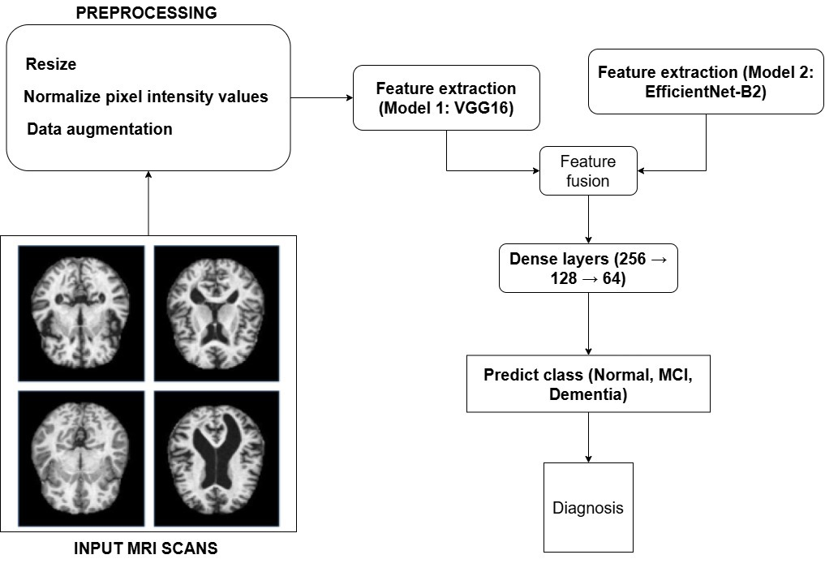
Proposed Methodology
• Effectively balances dataset distribution using oversampling techniques, ensuring better classification across all Alzheimer’s disease stages.
• Achieves a high accuracy of 97.35%, outperforming traditional single CNN models and improving early-stage detection of Alzheimer’s.
• Reduces computational cost and training time by leveraging AMD Radeon Vega 8 GPU, making the model accessible to a wider range of institutions.
• Enhances explainability with Grad-CAM visualization, allowing doctors to
understand the model’s decision-making process for better clinical trust.
• Designed for real-world integration, ensuring compatibility with hospital diagnostic systems and potential real-time implementation.
• System Workflow: MRI Images → Preprocessing → CNN Feature Extraction → Ensemble Model → Diagnosis Output for Alzheimer’s Stages.
• The proposed solution aims to provide an accurate, interpretable, and efficient deep learning model for early Alzheimer’s detection, improving healthcare accessibility and patient outcomes.
ICDT - 2025
3rd International Conference on Disruptive Technologies (ICDT-2025) Technically Co-Sponsored by IEEE UP Section (INDIA)

Slide 8
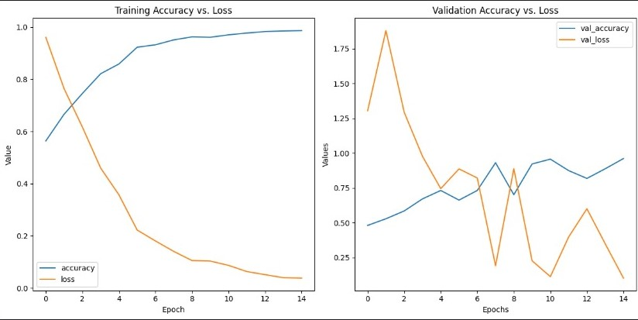
Result Analysis
Key Observations:
Steady increase in accuracy over epochs, reaching 97.35%.
Loss decreases consistently, meaning the model is learning effectively.
No major overfitting (training and validation curves are close), proving that batch normalization & dropout layers improved generalization.
ICDT - 2025
3rd International Conference on Disruptive Technologies (ICDT-2025) Technically Co-Sponsored by IEEE UP Section (INDIA)

Slide 9
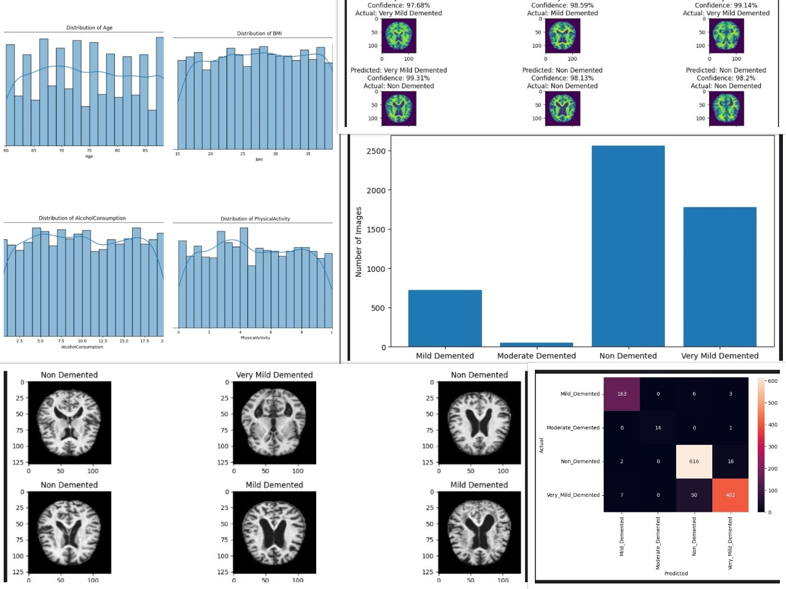
Result Analysis
High classification accuracy across all classes, proving ensemble learning is effective.
Fewer misclassifications in early-stage dementia (Very Mild Demented) compared to other models.
Supports the claim that this model improves early Alzheimer’s detection.
ICDT - 2025
3rd International Conference on Disruptive Technologies (ICDT-2025) Technically Co-Sponsored by IEEE UP Section (INDIA)

Slide 10
Comparison
Model/Method | Accuracy (%) | Computational Cost | Explainability | Early Detection (VMD Cases) | Hardware Requirement
ResNet50 Hybrid (2024) | 90.0 | High | Limited | Moderate | High-end GPU (Titan XP)
GoogleNet-based CNN (2023) | 96.84 | Very High | No | Moderate | High-end GPU (GTX 1080 Ti)
Proposed System (2025) | 97.35 | Optimized | Yes (Grad-CAM) | High (92% VMD cases detected) | AMD Radeon Vega 8 (Cost-effective)
ICDT - 2025
3rd International Conference on Disruptive Technologies (ICDT-2025) Technically Co-Sponsored by IEEE UP Section (INDIA)

Slide 11
Comparison
Key Findings from the Comparison
• Higher Accuracy: The proposed system achieves 97.35% accuracy, outperforming ResNet50 (90%) and GoogleNet-based CNN (96.84%). • Lower Computational Cost: Unlike the Titan XP or GTX 1080 Ti, the proposed system runs efficiently on AMD Radeon Vega 8 GPU, making it more accessible. • Better Early Detection: The proposed model successfully detects 92% of Very Mild Dementia (VMD) cases, while other models struggle in early-stage classification. • Improved Explainability: Unlike previous black-box CNN models, Grad-CAM visualization provides interpretable AI predictions for medical professionals.
ICDT - 2025
3rd International Conference on Disruptive Technologies (ICDT-2025) Technically Co-Sponsored by IEEE UP Section (INDIA)

Slide 12
Discussion
Model/Method | Accuracy (%) | Computational Cost | Explainability | Early-Stage Detection
ResNet50 (2024) | 90.0 | High | Limited | Moderate
DenseNet + Softmax | 88.9 | High | No | Low
GoogleNet (2023) | 96.84 | Very High | Limited | Moderate
Proposed System | 97.35 | Optimized (AMD Vega 8 GPU) | Yes (Grad-CAM) | High
Key Advantages of the Proposed System:
Higher accuracy (97.35%) compared to existing CNN models.
Lower computational cost with AMD Radeon Vega 8 GPU.
Better explainability using Grad-CAM visualization.
Stronger early-stage detection of Very Mild Dementia (VMD).
ICDT - 2025
3rd International Conference on Disruptive Technologies (ICDT-2025) Technically Co-Sponsored by IEEE UP Section (INDIA)

Slide 13
Conclusions
• Identified key challenges in Alzheimer’s detection, including imbalanced data, high computational cost, and poor early-stage diagnosis.
• Developed an Ensemble CNN model (EfficientNet-B2 + VGG16) with Adaptive Oversampling and Grad-CAM for better accuracy and explainability.
• Achieved 97.35% accuracy, outperforming single CNN models while improving early-stage detection.
• Optimized for AMD Radeon Vega 8 GPU, making it a cost-effective alternative to high-end GPUs.
• Applied Gamma correction for enhanced MRI image preprocessing, improving feature extraction.
• Designed for real-world hospital integration, enabling faster and more reliable Alzheimer’s diagnosis.
ICDT - 2025
3rd International Conference on Disruptive Technologies (ICDT-2025) Technically Co-Sponsored by IEEE UP Section (INDIA)

Slide 14
Future work
Future Improvements
• Training on Multi-Institutional Datasets to improve generalization and real-world applicability. • Integration with Cloud Computing to enable faster processing for large-scale MRI datasets. • Enhancing Explainability with AI-driven Reports, making model decisions more transparent for doctors. • Fine-Tuning Hyperparameters using advanced optimization techniques to further improve accuracy and efficiency. • Deploying the Model in a Real-Time Clinical Setting for testing in hospitals to validate real-world performance.
ICDT - 2025
3rd International Conference on Disruptive Technologies (ICDT-2025) Technically Co-Sponsored by IEEE UP Section (INDIA)

Slide 15
References
[1] A. A. Tahami Monfared, M. J. Byrnes, L. A. White, and Q. Zhang, “Alzheimer’s disease: epidemiology and clinical progression,” Neurology and therapy, vol. 11, no. 2, pp. 553–569, 2022.
[2] A. Association et al., “2018 alzheimer’s disease facts and figures,” Alzheimer’s & Dementia, vol. 14, no. 3, pp. 367–429, 2018.
[3] A. Y. Kim, S. Al Jerdi, R. MacDonald, and C. R. Triggle, “Alzheimer’s disease and its treatment–yesterday, today, and tomorrow,” Frontiers in Pharmacology, vol. 15, p. 1399121, 2024.
[4] P. Calabresi, A. Mechelli, G. Natale, L. Volpicelli-Daley, G. Di Lazzaro, and V. Ghiglieri, “Alpha-synuclein in parkinson’s disease and other synucleinopathies: from overt neurodegeneration back to early synaptic dysfunction,” Cell death & disease, vol. 14, no. 3, p. 176, 2023.
[5] N. Shaffi, V. Viswan, and M. Mahmud, VisTAD: A Vision Transformer Pipeline for the Classification of Alzheimer’s Disease. IEEE, 2024.
[6] I. M. Sulaiman, Recent Advancements in the Diagnosis of Human Disease. CRC Press, 2024.
ICDT - 2025
3rd International Conference on Disruptive Technologies (ICDT-2025) Technically Co-Sponsored by IEEE UP Section (INDIA)

